Slide 1
Integrating Genomic Data: More Annotation Tools and Interpretation
HUGEN 2073
Genomic Data Visualization and Integration
Jon Chernus

Slide 2
Last time
Querying LD information from 1000 Genomes Project with LDlink
Using the R package LDlinkR to retrieve LD information
Using LDlinkR to combine LD information with other annotation
e.g., find SNPs in LD with a given set of SNPs
e.g., find eQTLs, prior GWAS associations in LD with a given set of SNPs
Flexibility in specifying population, strength of LD, and distance
VEP (Variant Effect Predictor)
Online (or command line) tool for mapping variants to transcripts and other genome elements
Genic/exonic/intronic/regulatory consequences
Predicted deleteriousness (PolyPhen, SIFT, CADD)
More annotations
Querying variants for regulatory function
HaploReg: query variants in LD for enhancer/eQTL/evidence of regulatory role
RegulomeDB: similar to HaploReg
Quantifies “probability” of a variant having regulatory function
“Ranks” variants according to qualitative evidence strength
HaploReg/RegulomeDB can be accessed with the R package HaploR (which is a little bug-gy)

Slide 3
This lecture
More detailed discussion of variant “consequences”
Review of coding/genic variant terminology
Review of amino acid substitution
Meaning of SIFT/PolyPhen/CADD scores
“Clinical” phenotype associations
OMIM
ClinVar (/ClinGen)
Using VEP, variation browser, and UCSC Genome Browser to query these
“High-throughput” annotation with ANNOVAR
“Interpretation” of annotations/evidence

Slide 4
Classifying genic variation
Exonic
Synonymous
Missense
Stop-gain/nonsense
Stop-loss
Indel/frameshift
(Synonymous exonic variants can alter splicing, too – preventing ”normal” splicing or adding ”abnormal” splicing)
UTR variation
Intronic
Splice site

Slide 5
Codons
Notes:
https://upload.wikimedia.org/wikipedia/commons/3/31/Codons_aminoacids_table.png

Slide 6
Synonymous variants
Don’t change amino acid Examples: GAG to GAA AGC to AGU UUA to CUA
Synonymous SNPs may still matter (e.g., by affecting protein binding or splicing)

Slide 7
Missense variants
Substitute one amino acid for another Examples: GAG to GAC AGA to ACA CCA to UCA

Slide 8
Amino acids
Not all amino acid substitutions are equally significant. Some may be well-tolerated, while others may be highly deleterious.
Notes:
https://en.wikipedia.org/wiki/Amino_acid#/media/File:Amino_Acids.svg

Slide 9
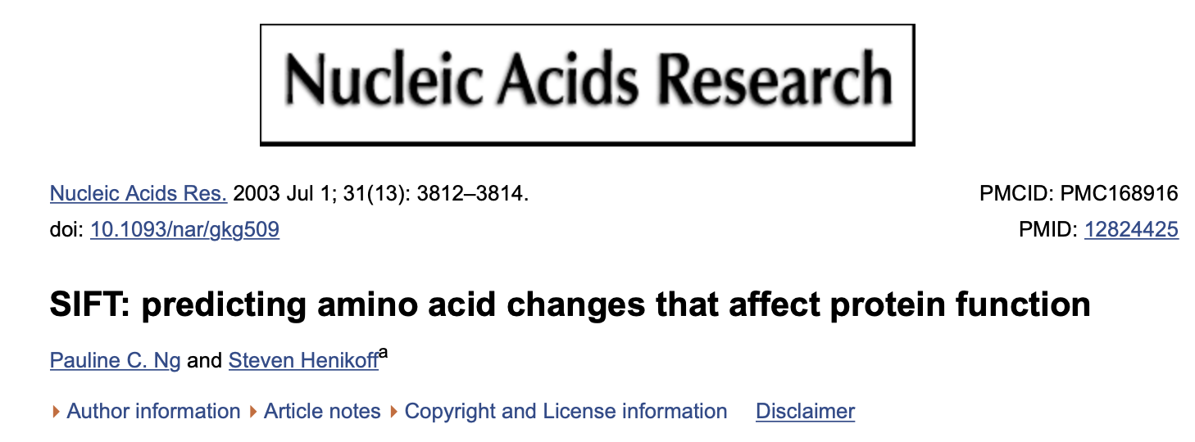
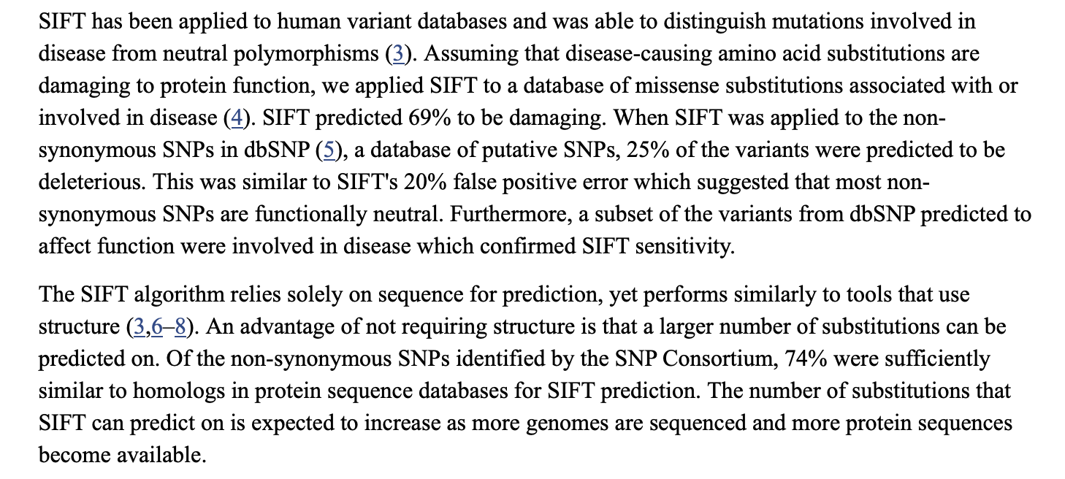
Missense variation
SIFT score (Sorting Intolerant From Tolerant)
Predicts deleteriousness of amino acid substitutions Uses position and conservation (not structure)
Output: number between 0 and 1 (smaller=predicted “more intolerant”/more deleterious, larger=more likely benign) Score < 0.05 is a common cutoff for predicting probably “damaging”/”deleterious”
Recall we can access SIFT scores through VEP
https://sift.bii.a-star.edu.sg

Slide 10
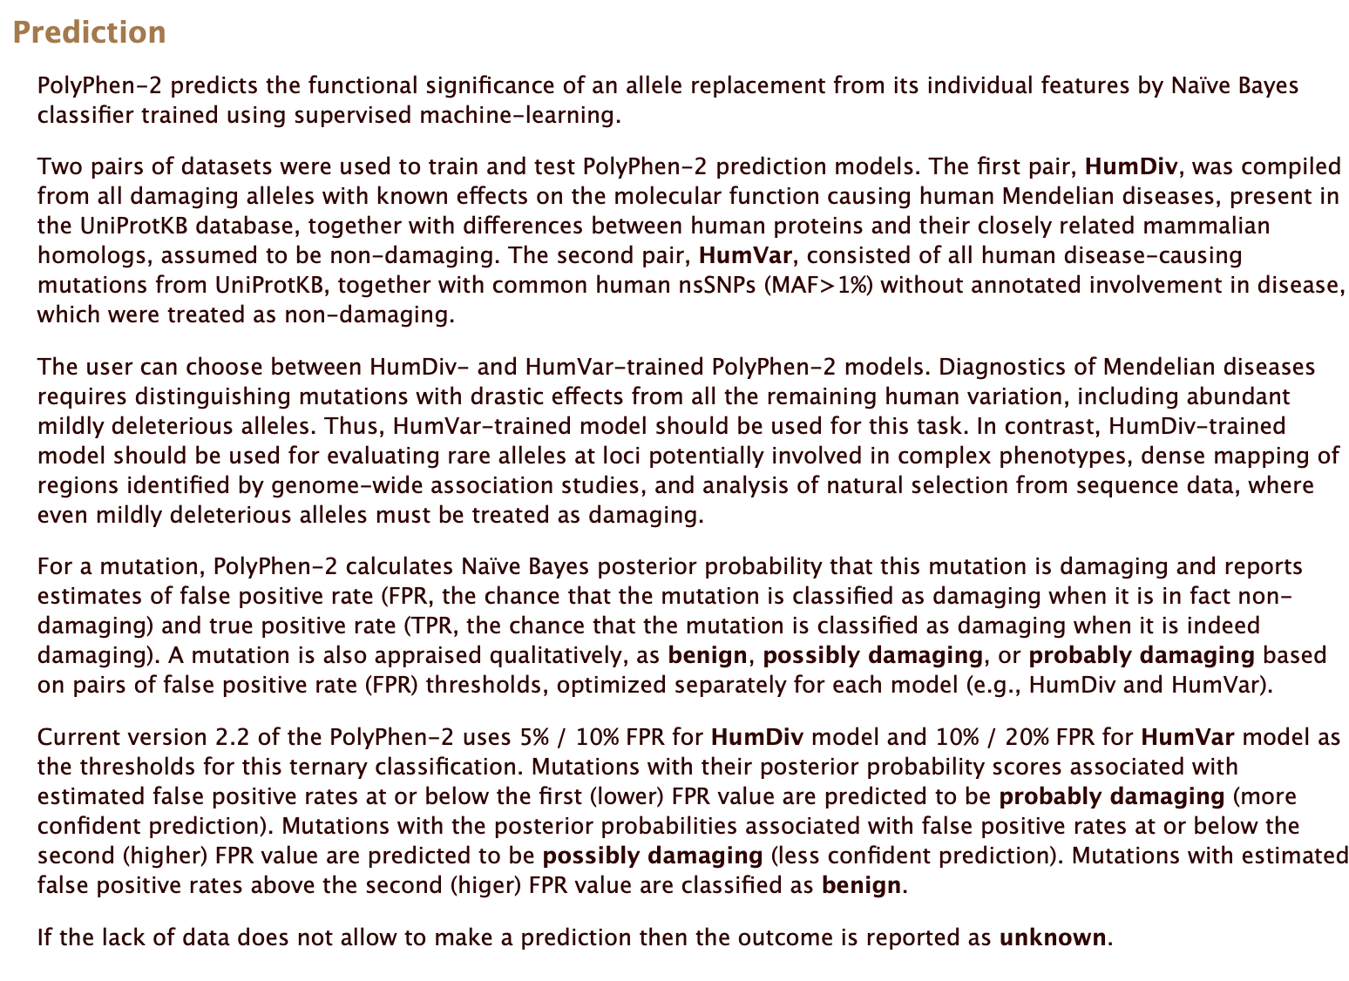
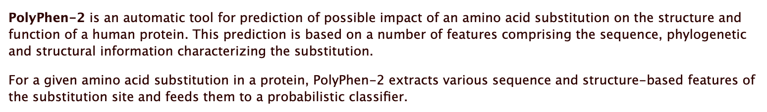
Missense variation
PolyPhen
http://genetics.bwh.harvard.edu/pph2/

Slide 11
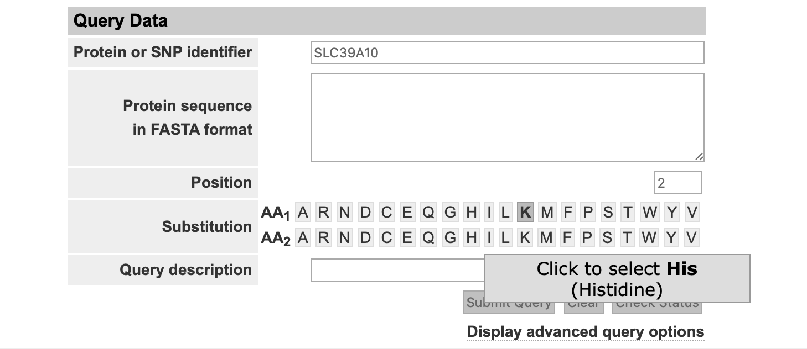
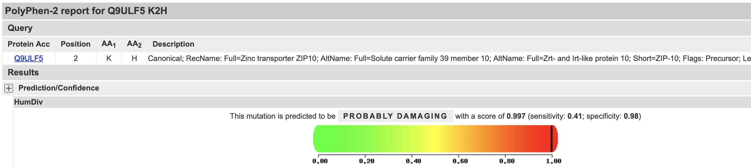
PolyPhen
Scores range from 0 to 1. Closer to 0 = predicted more likely to be benign Close to 1 = predicted more likely to be deleterious
Access through web tool or VEP

Slide 12
Stop-gain/nonsense variants
Nonsense mutations refer to gain of a premature stop codon, resulting in a truncated protein (or may not be translated). Examples: GAG to UAG UCA to UAA UGG to UGA Losing a start codon is also possible. Examples: AUG to CUG

Slide 13
Stop-loss and start-gain variants
Stop-loss examples: UGA to UGC UAA to UCA UAG to UAU
Start-gain examples: CUG to AUG AGG to AUG AUC to AUG

Slide 14
Indel/frameshift variants
An insertion/deletion (in a gene) whose length isn’t divisible by 3 causes a frameshift.
Some examples:
Sequence | Variation | Consequence/description
ATG TTC CCT UTT AGT … | N/A | Original sequence
ATG GTT CCC TUT TAG T.. | 1bp insertion | Frameshift. Second and all subsequent amino acids “change.”
ATG TTC CCT UAG T… ^{^TT} | 2bp deletion | “Frameshift” → Stop gain
ATG TTC UTT AGT … ^{^CCT} | 3bp deletion | One amino acid is deleted; others stay the same.

Slide 15
UTR variation
5’-UTR and 3’-UTR (untranlated region) variation may affect gene regulation.
Notes:
https://www.ensembl.info/2018/08/17/ensembl-insights-how-are-utrs-annotated/

Slide 16
Intron variation
Notes:
https://m.ensembl.org/info/genome/variation/prediction/consequences.jpg

Slide 17
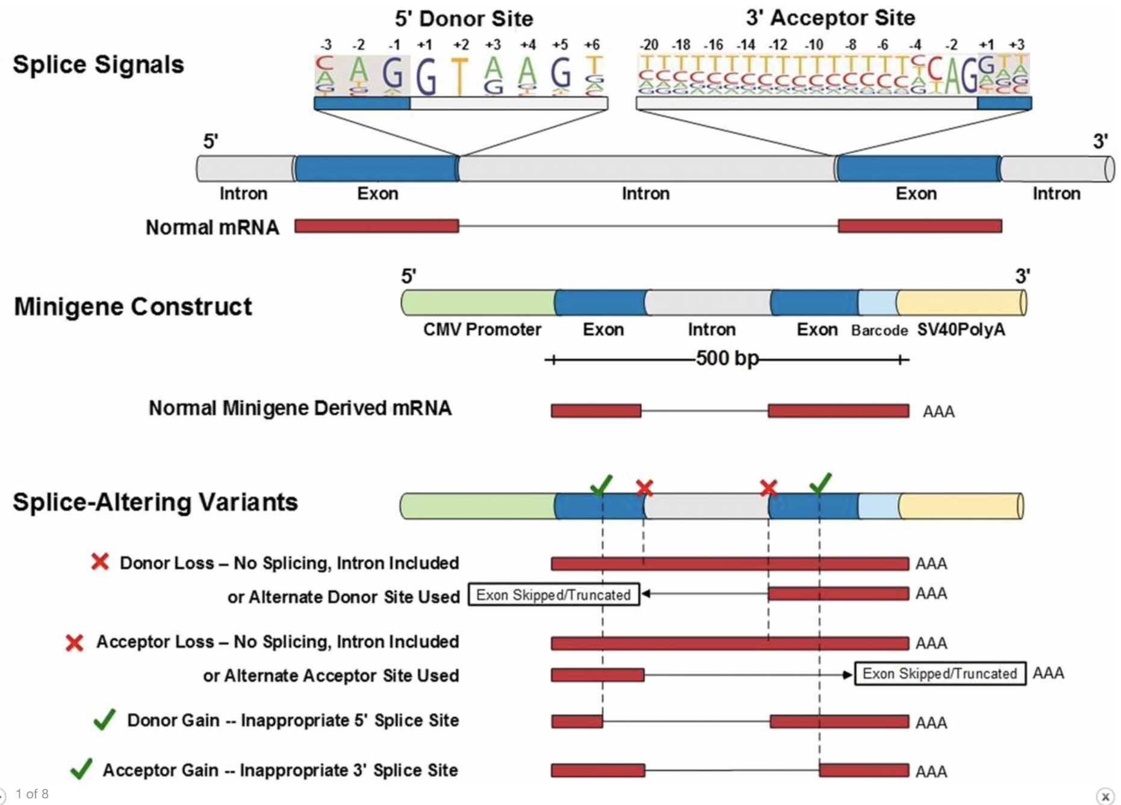
Intron variation – some possible consequences
Adapted from https://www.pnas.org/content/114/29/7689

Slide 18
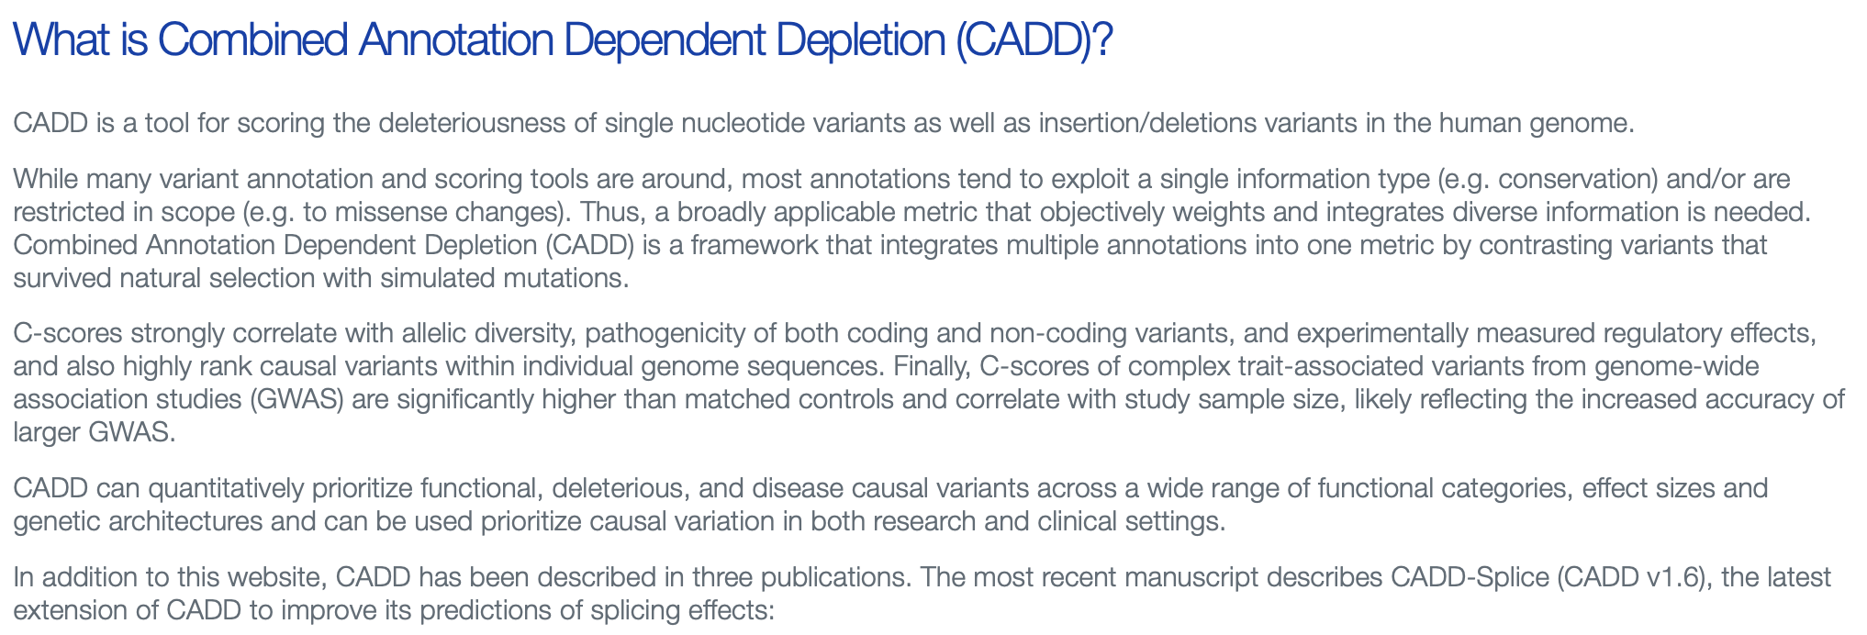
CADD score
https://cadd.gs.washington.edu
For any non-coding variant, is it possible to define a “deleteriousness” score?
CADD = Combined Annotation Dependent Depletion

Slide 19
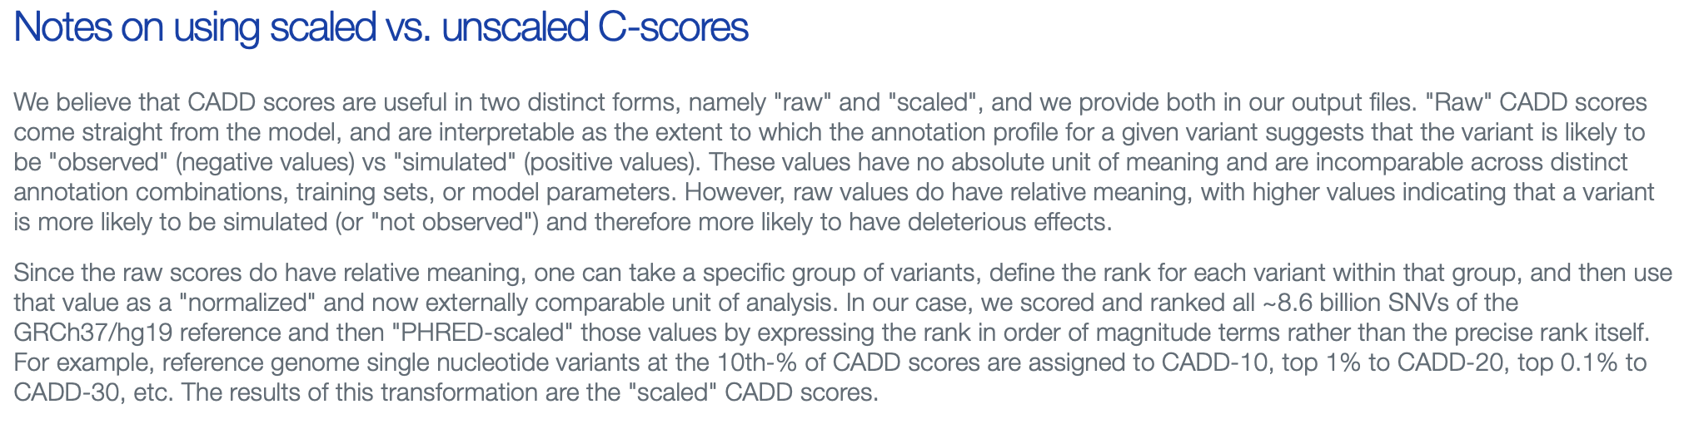
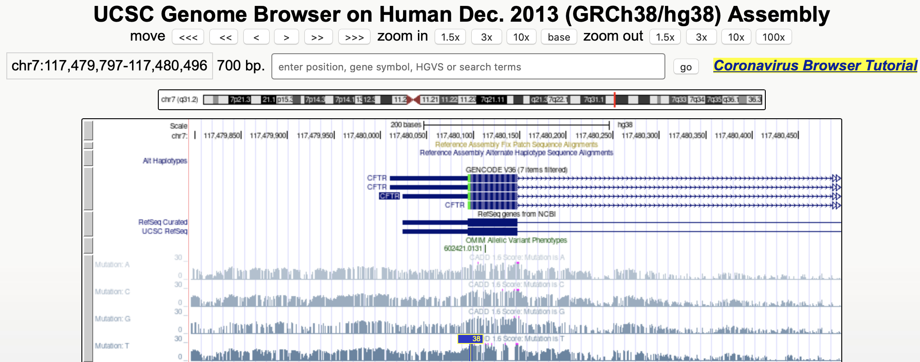
CADD score

Slide 20
CADD score
Access
VEP
UCSC Genome Browser
Upload VCF to CADD website

Slide 21
Clinical significance
We discussed a few kinds of associational evidence that a variant might be involved with a phenotype, for example:
Being in a gene/regulatory element
LD with a GWAS association (GWAS Catalog)
LD with an eQTL
We also talked about various predictive tools (SIFT, PolyPhen, CADD, RegulomeDB score, etc.)
We can also ask what kind of clinical evidence exists for a specific variant (or gene) of interest.

Slide 22
ClinVar
https://www.ncbi.nlm.nih.gov/clinvar/
ClinVar is a database of variants and reports/“assertions” of their relevance to disease/phenotypes
Entries come from submissions
Clinical labs
Researchers
Expert panels
Other databases
Other sources…
Only observed variation gets into ClinVar
Assertions about the same variant may be inconsistent; or there may be a consensus; or there may be only a single report

Slide 23
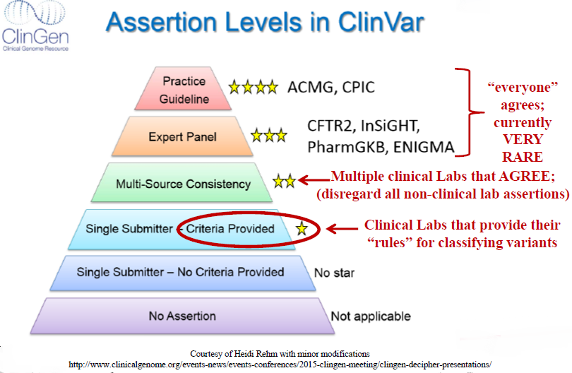
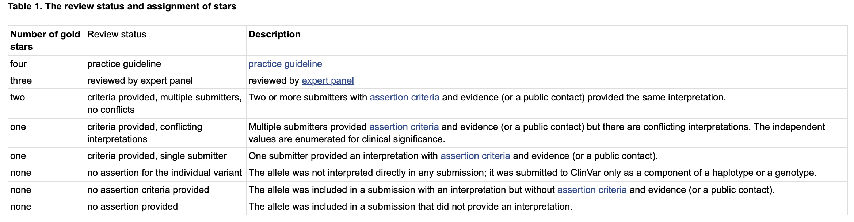
ClinVar
Figure borrowed from: Bioinformatics Databases with Clinical Relevance Natalie Carter, MS, LCGC HUGEN 2070: Bioinformatic Resources for Geneticists November 1, 2019
Each variant comes with a “review status” in the form of 0-4 gold stars

Slide 24
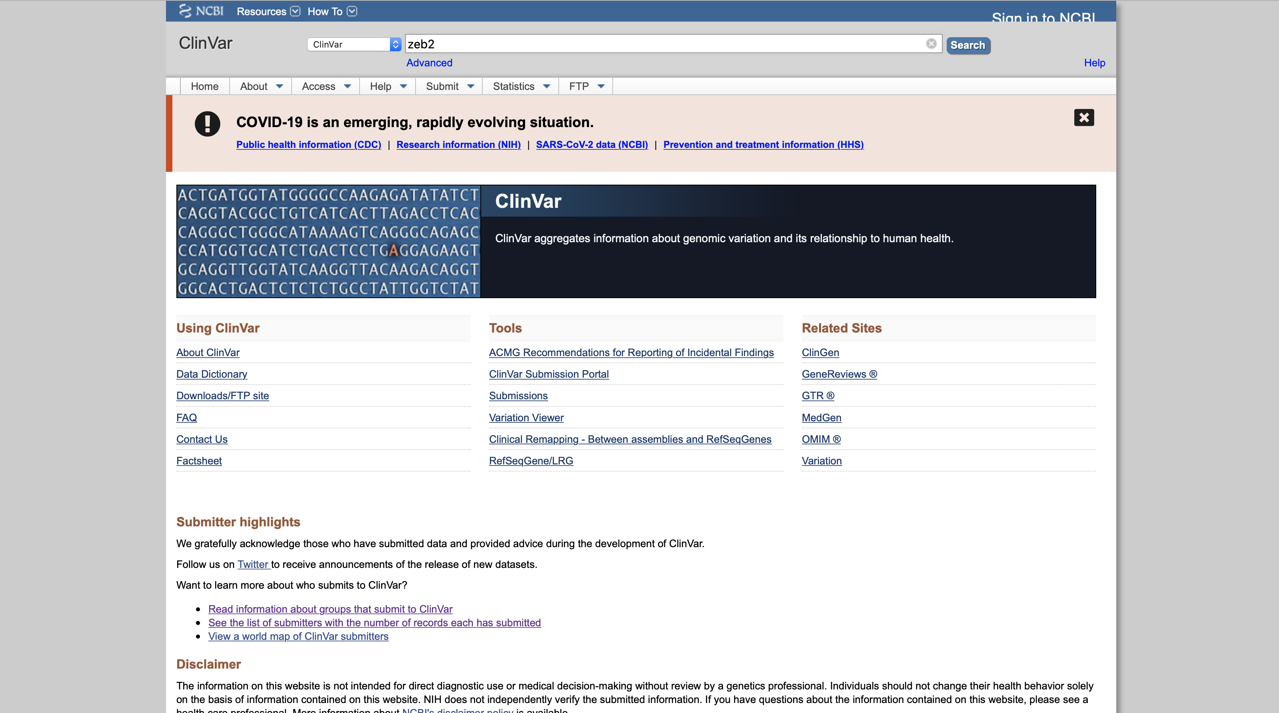
ClinVar
Possible searches: variant (HGVS, rsID, gene name, phenotype, )

Slide 25
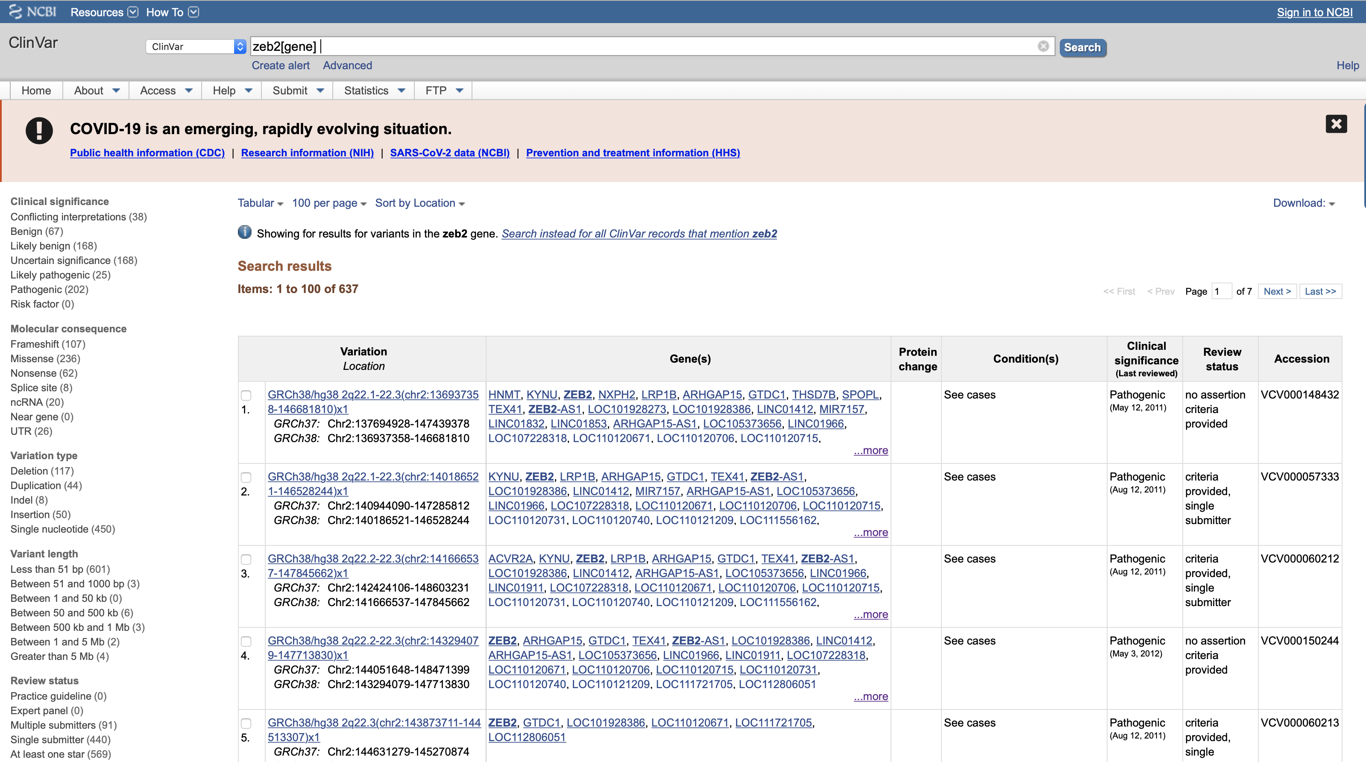
Search ClinVar for a gene
Result: all variants in that gene

Slide 26
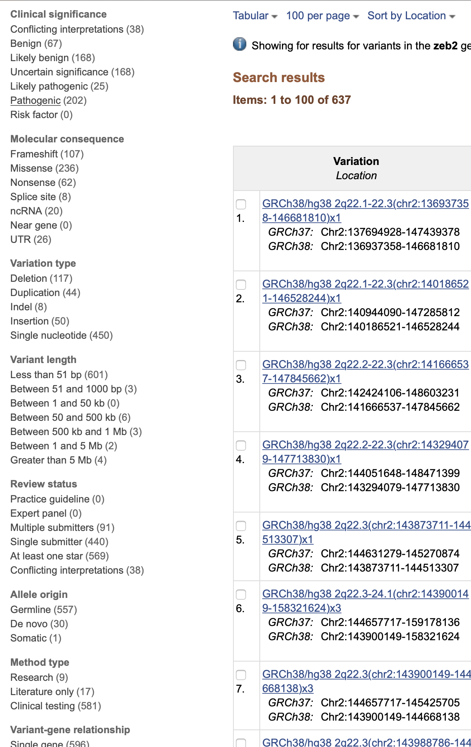
Search ClinVar for a gene
Use the panel at the left to filter
Select “Pathogenic” variants, e.g.
Select only “large” variants > 500kb in length, e.g.
Select only genes with multiple submitters, e.g.

Slide 27
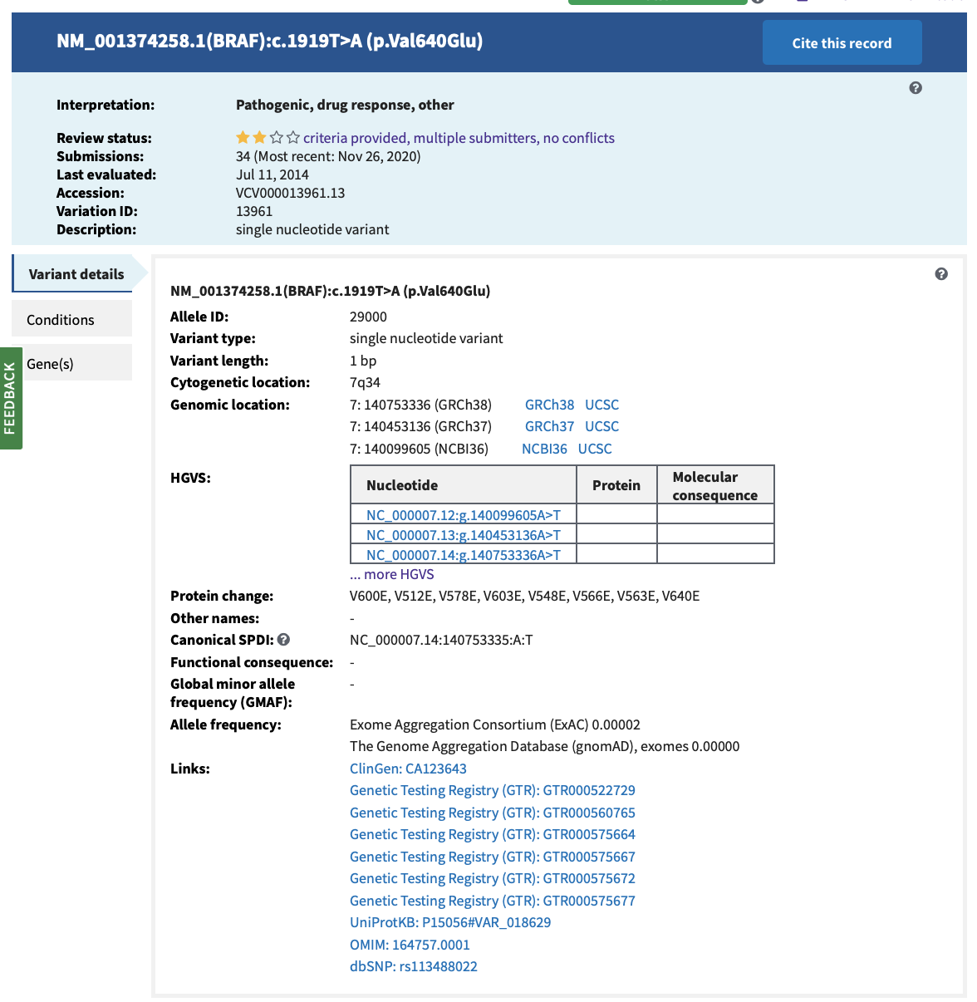
Search ClinVar for a variant
For example, search by HGVS name (“NM_004333.4:c.1799T>A”) This leads directly to the variant’s page, since there’s only 1 search result
Can also enter queries like:
1799T>A BRAF
1799T>A
rs113488022
NP_004324.2:p.Val600Glu
P.Val600Glu
V600E
(You may get multiple results)

Slide 28
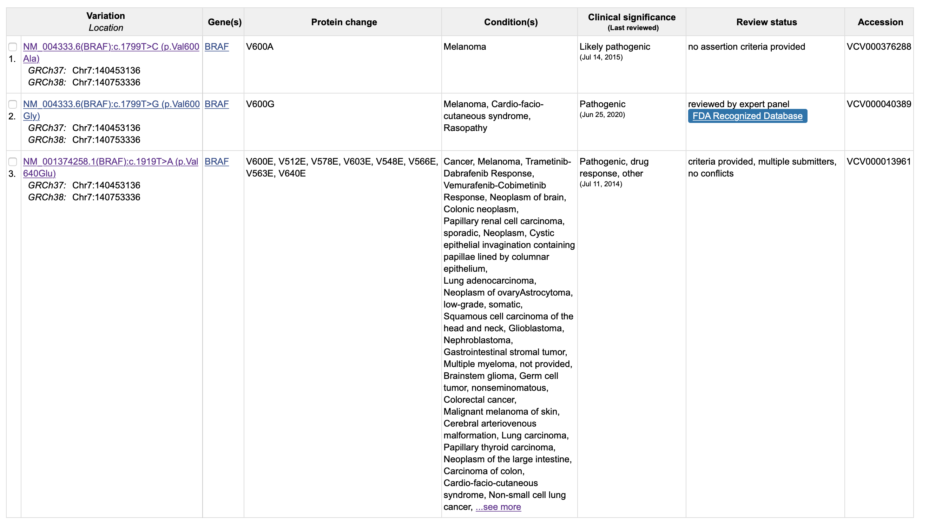
Searching ClinVar for a variant (rs113488022)

Slide 29
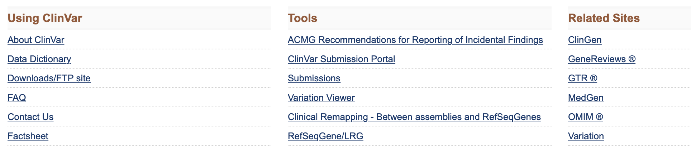
Searching ClinVar for a region: Using the Variation Viewer

Slide 30
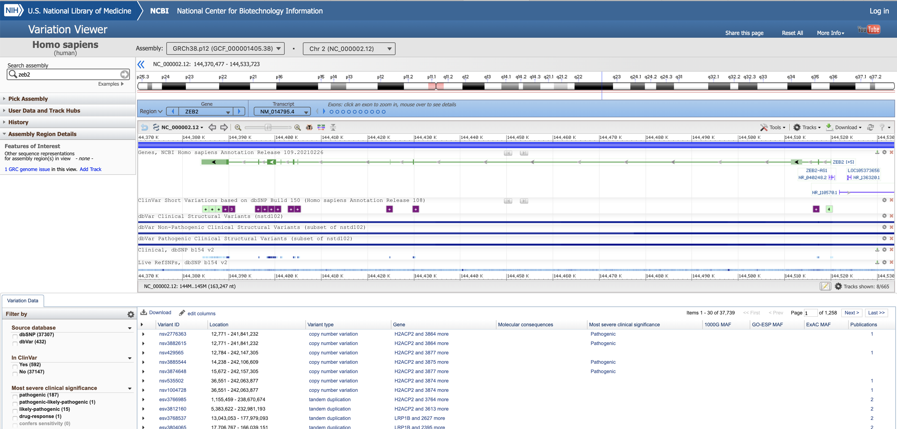
Variation Viewer
Search: ZEB2 gene
Variants in ClinVar

Slide 31
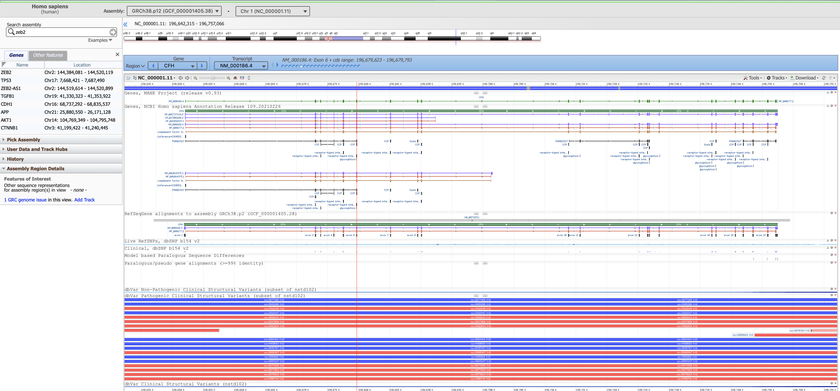
Variation Viewer
Search: ZEB2 gene
Structural variation in ClinVar (blue=dup., red=del.)

Slide 32
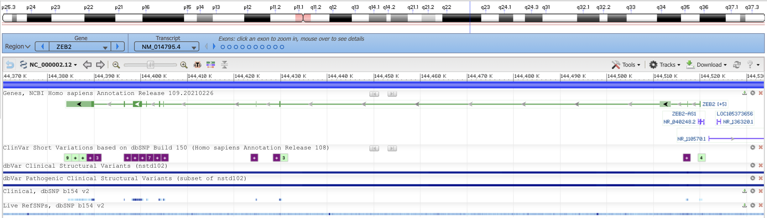
Variation Viewer
Zoom in all the way to base-pair level
Zoom into an exon of your choice
Zoom in/out
Edit tracks
Variants in ClinVar

Slide 33
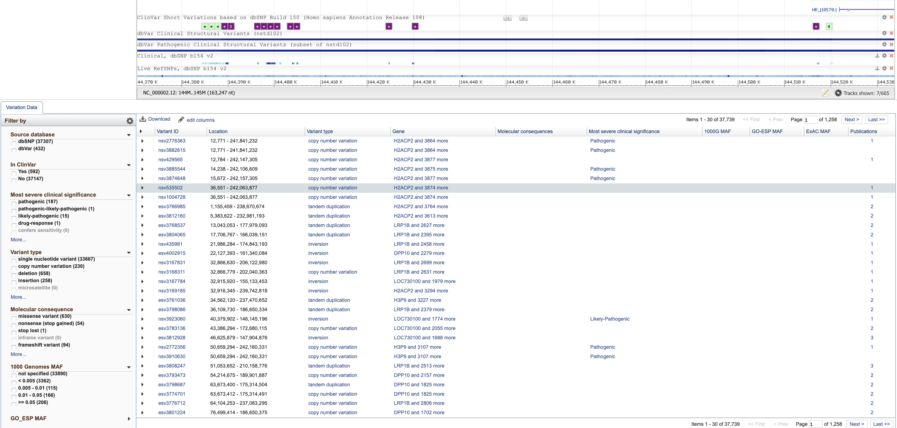
Variation Viewer
Below the viewer window is a table of all the ClinVar variants currently in the window. The table updates automatically as the window moves.

Slide 34
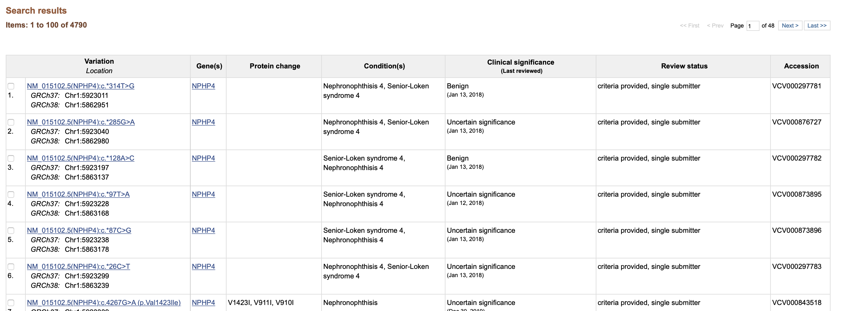
Searching ClinVar for traits
I searched “cystic fibrosis.” Note that CF isn’t mentioned in the Condition(s).
Your search term may show up somewhere in the individual variants’ entries.

Slide 35
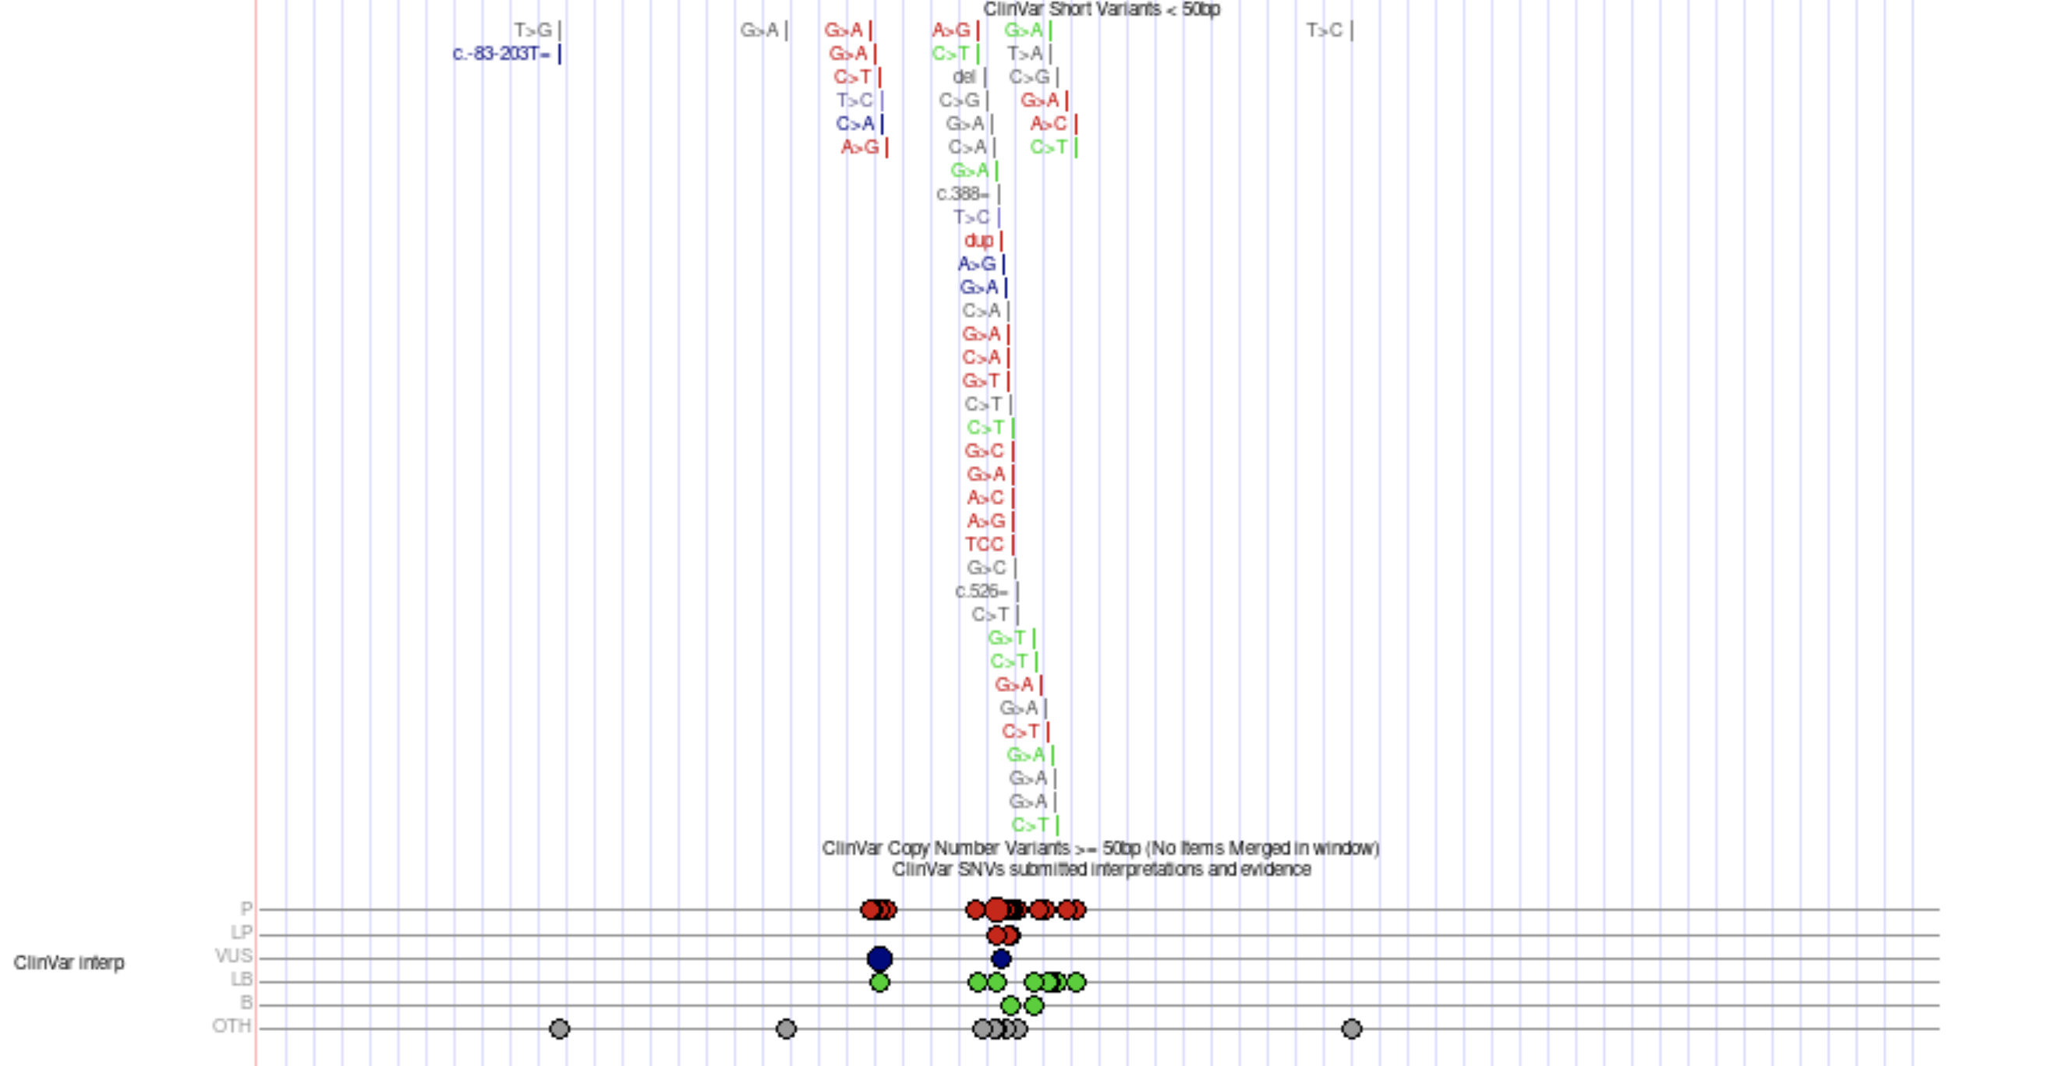
ClinVar track in UCSC Genome Browser

Slide 36
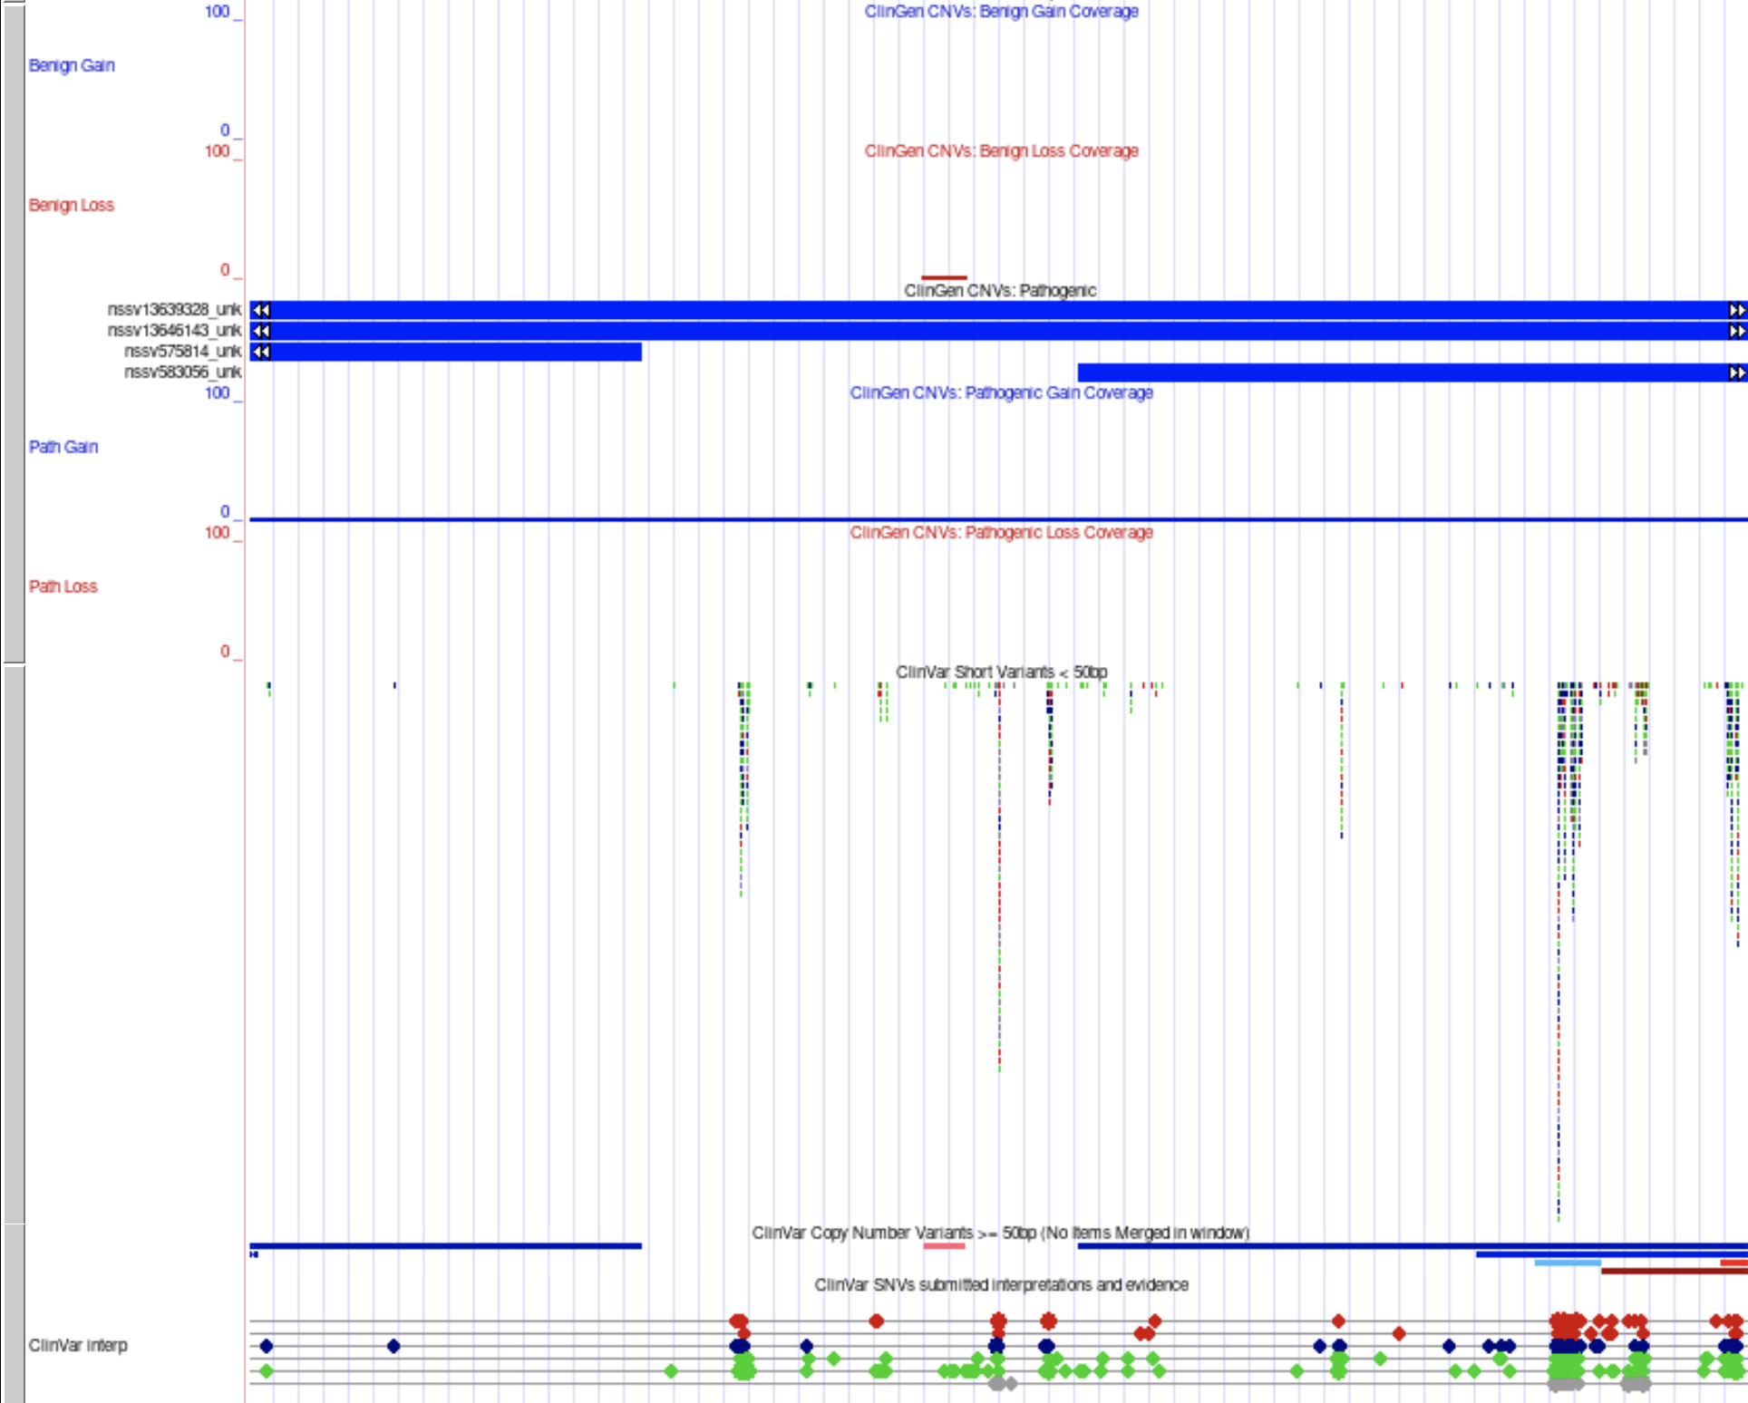
ClinVar tracks in UCSC Genome Browser
Here the short ClinVar variants are squished, and the structural variants are shown.
The blue bars represent “pathogenic” gains in copy number.

Slide 37
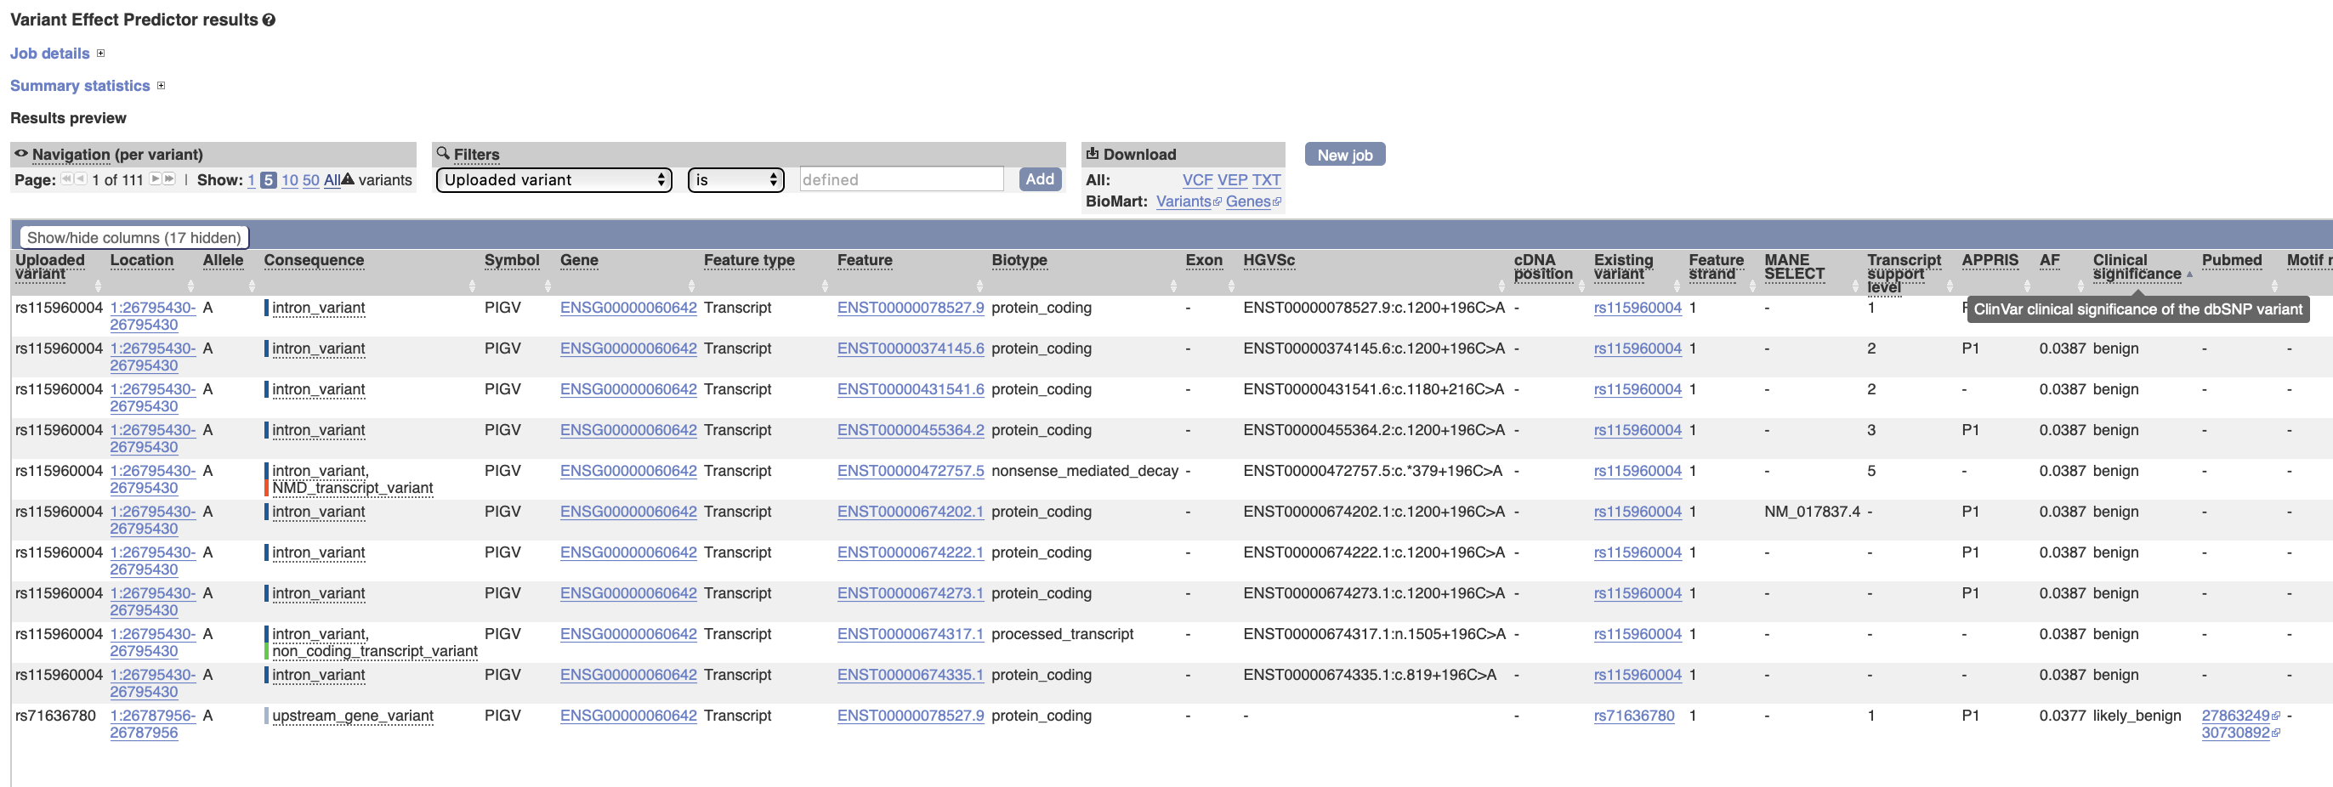
ClinVar annotation in VEP

Slide 38
OMIM- Online Mendelian Inheritance in Man
https://www.ncbi.nlm.nih.gov/omim (create bookmarks!)
Open access
Listings of genes associated with human disease or syndrome
Authored summaries of primary research articles
Slide borrowed from: Bioinformatics Databases with Clinical Relevance Natalie Carter, MS, LCGC HUGEN 2070: Bioinformatic Resources for Geneticists November 1, 2019
Notes:
Authored and edited by (curated) geneticists/students at Johns hopkins, under direction of Ada Hamosh, a respected geneticist

Slide 39
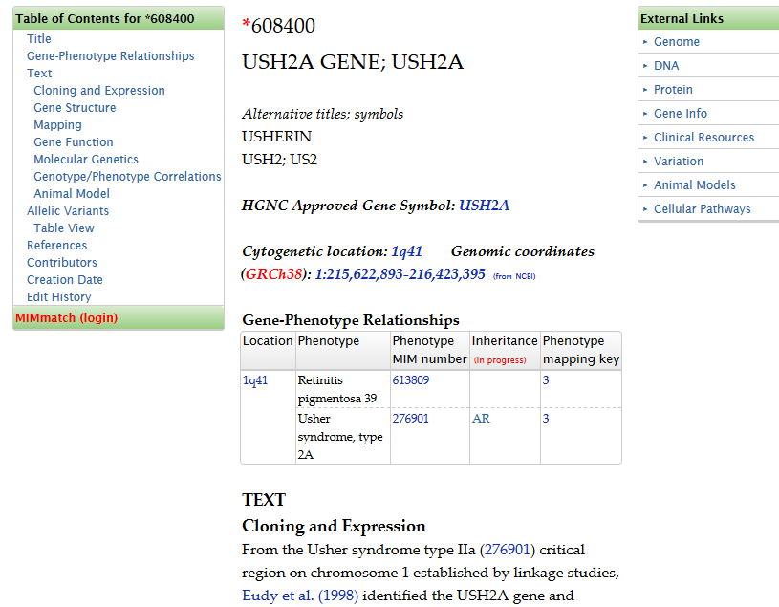
Search: USH2A Gene
Lists syndromes associated with the gene
Links, links and more links
Info on some reported variants in “Allelic Variants”
Note the edit history
Slide borrowed from: Bioinformatics Databases with Clinical Relevance Natalie Carter, MS, LCGC HUGEN 2070: Bioinformatic Resources for Geneticists November 1, 2019
Notes:
Scroll all the way to the bottom to see the edit history for this entry

Slide 40
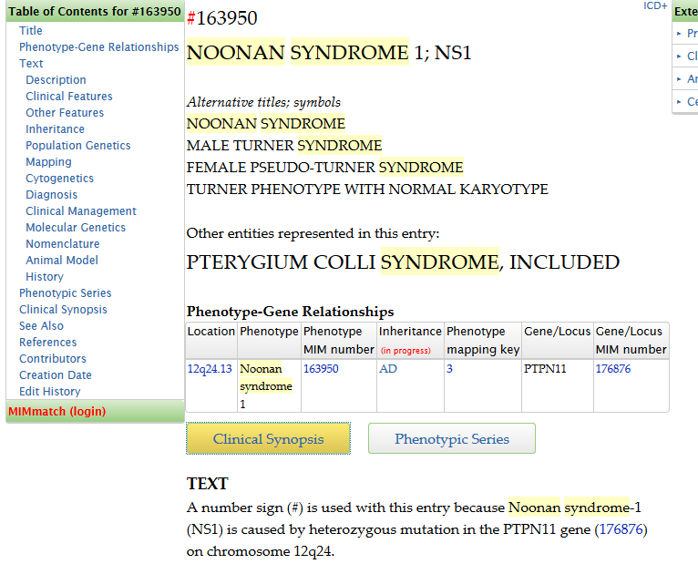
Search: Noonan syndrome
Clinical synopsis
List of features (by body system)
Alternative names
Slide borrowed from: Bioinformatics Databases with Clinical Relevance Natalie Carter, MS, LCGC HUGEN 2070: Bioinformatic Resources for Geneticists November 1, 2019

Slide 41
OMIM- Limitations/Potential Pitfalls
Syndrome caused by multiple genes (like Noonan syndrome) has an entry for each gene
Difficult to get a snapshot of all the genes associated with a particular syndrome
Should not replace a PubMed search
Edit history
Not complete
Summaries are not for a lay audience
Slide borrowed from: Bioinformatics Databases with Clinical Relevance Natalie Carter, MS, LCGC HUGEN 2070: Bioinformatic Resources for Geneticists November 1, 2019
Notes:
13 or more genes a/w NS

Slide 42
GeneReviews
www.genereviews.org
Open access
Chapters written by experts and peer reviewed
Details for diagnosis
Genetic testing information
Syndrome based
Favor toward syndromes with available (single gene) genetic testing
Slide borrowed from: Bioinformatics Databases with Clinical Relevance Natalie Carter, MS, LCGC HUGEN 2070: Bioinformatic Resources for Geneticists November 1, 2019

Slide 43
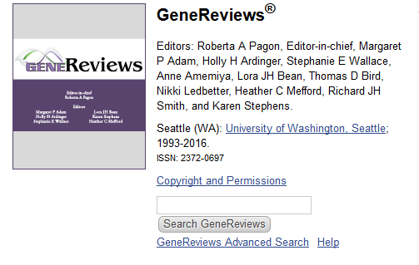
Search: Noonan
Use the Search GeneReviews box, not the NCBI search
Slide borrowed from: Bioinformatics Databases with Clinical Relevance Natalie Carter, MS, LCGC HUGEN 2070: Bioinformatic Resources for Geneticists November 1, 2019
Notes:
Pulls up all entries that discuss Noonan syndrome (some have it as a similar or related diagnosis)
Choose option by JE Allanson and AE Roberts

Slide 44
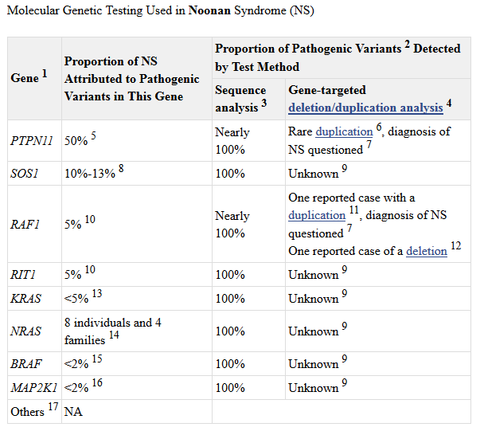
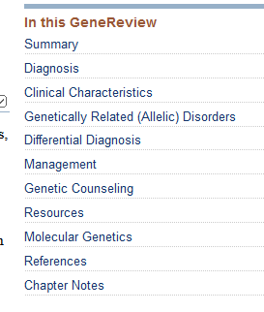
Slide borrowed from: Bioinformatics Databases with Clinical Relevance Natalie Carter, MS, LCGC HUGEN 2070: Bioinformatic Resources for Geneticists November 1, 2019
Notes:
Similar to a book chapter on this disorder- sections on the right hand column
- Summary of the gene, including all genetic causes in one place

Slide 45
“Higher-throughput” annotation
How can a very large dataset be efficiently annotated?
That is, how can we combine all of the types of annotation we’ve discussed for a large number of variants (e.g., a VCF file from a sequencing project, with 5 million SNPs and 500,000 indels)?
One commonly-used tool is the command-line program ANNOVAR, which can annotate your variants with the data underlying essentially any track of the UCSC Genome Browser – or your own data.

Slide 46
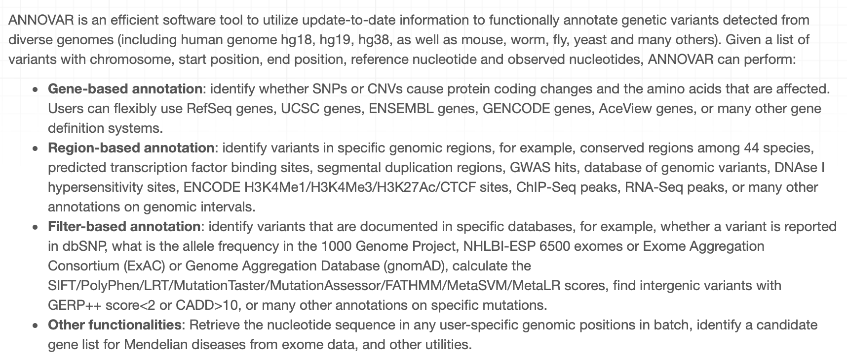
ANNOVAR inputs and basic functions

Slide 47
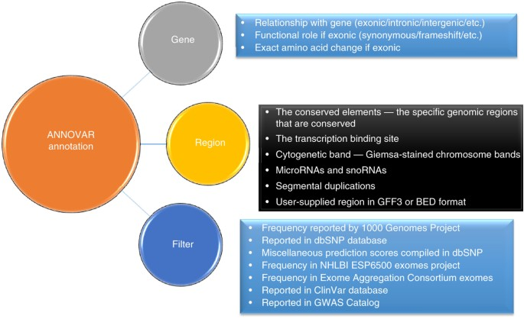
ANNOVAR
Website https://annovar.openbioinformatics.org/en/latest/
Documentation https://academic.oup.com/nar/article/38/16/e164/1749458
https://www.nature.com/articles/nprot.2015.105
To run ANNOVAR, you have to locally save copies of the annotation databases you want to use (ANNOVAR will do this for you). Input: text-base file with one line per variant. Must include chromosome, start/end positions, and alleles.
Types of annotation:
Gene-based (e.g., RegSeq, UCSC, ENSEMBL, GENCODE)
Region-based (e.g., conserved regions, chip-seq data, transcription factor binding sites, etc.)
Filter-based (i.e., matching variants to annotation based on exact position/alleles, and filtering on the annotation values)

Slide 48
ANNOVAR
ANNOVAR consists of several Perl scripts, some of which have multiple functions
annotate_variation # Download database # Optional arguments include genome build # Database examples: gene/refGene; 1000genomes; snp136; Cytoband; tfbsConsSites > perl annotate_variation.pl –downdb [options] <table_name> <output_path>
convert2annovar # Use this to convert VCF, Samtools, or other filetypes to the correct input format > perl convert2annovar.pl old_file.vcf –format vcf4 > new_file.vcf4
Notes:
https://www.youtube.com/watch?v=jtJGZ8vFsGw&t=1177s

Slide 49
ANNOVAR
annotate_variation #Use this script again to do gene-based annotation # Output = 2 files, one with non-exonic variant function (upstream, UTR, etc.), another with exonic function (e.g., nonsynonymous) > perl annotate_variation.pl new_file.vcf4 –buildver hg19 annotation_database_directory/
annotate_variation # Use this script again to do filter-based annotation (match by exact location+alleles) # Output = 2 files, one with known variants, the other with unmatched variants # You can also filter out variants based on the values of the annotate data > perl annotate_variation.pl new_file.vcf4 –filter –dbtype 1000g2012apir_EUR –buildver hg19 annotation_database_directory/

Slide 50
ANNOVAR
annotate_variation # Use this script again to do region annotation # Output: annotated file > perl annotate_variation.pl new_file.vcf4 –regionanno –dbtype <argument> –buildver hg19 [more options] annotation_database_directory/
summarize_annovar # Integrates results from multiple databases and outputs them to an Excel file
variants_reduction # Allows more advanced/customized filtering options across multiple values across multiple databases, with the goal of helping you prioritize/identify causal variants
retrieve_seq_from_fasta # Retrieve base sequence for region
coding_change # Retrieves protein sequence (for “reference” vs for “mutated” genome)

Slide 51
ANNOVAR vignette
Example from ANNOVAR paper
Try to find a Mendelian disease gene in an individual’s sequence data
Approach: Take sequence data from “unaffected” people and add in known Mendelian disease variants to “simulate” the disease
Use a simple annotation/filtering procedure to whittle down the list of genes and try to come up with the causal genes
The example at the right uses 1 subject to get to 20 genes (Note that PolyPhen calls one of the causal mutations “benign”)
In a different example, intersecting gene lists from 4 people
1 subject → 159 genes
2 subjects → 13 genes
3 subjects → 6 genes
4 subjects → 4 genes (including the causal gene)
SIFT + PolyPhen → 2 genes (including causal gene)
https://academic.oup.com/nar/article/38/16/e164/1749458

Slide 52
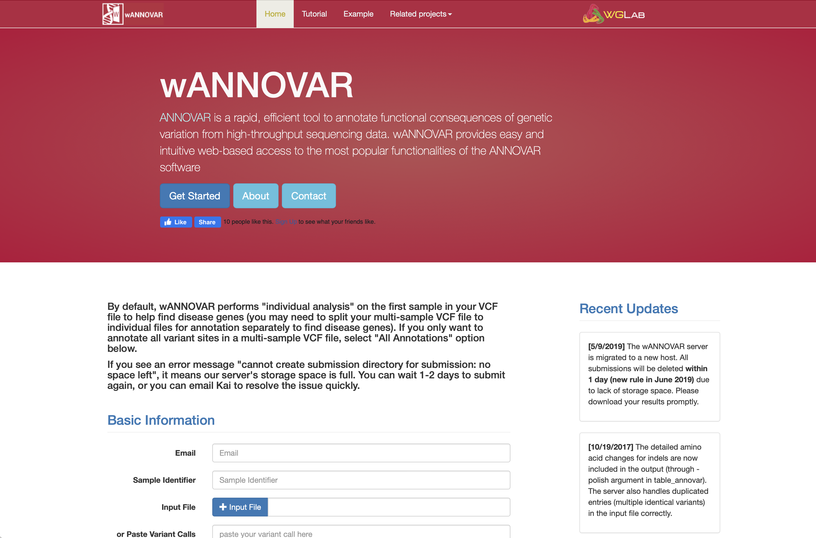
wANNOVAR
https://wannovar.wglab.org
https://www.ncbi.nlm.nih.gov/pmc/articles/PMC3556337/

Slide 53
Some guidelines for interpreting evidence
What to do now with all this annotation?
You should just publish the plot and the table, right? (No.)
Genome-wide meta-analysis of preference for pineapple on pizza
SNP | P | Annot1 | Annot2 | Annot3 | … | Annot738
chr1:135367430 | 2.4E-01 | GENE1 | Missense | Pathog. | ... | 104.633
chr1:111988570 | 1.7E-02 | GENE2 | Intronic | Benign | ... | 57245.16
chr1:112070215 | 5.4E-01 | GENE3 | Synon. | Benign | ... | 12456.33
chr1:112091824 | 1.0E-01 | GENE4 | Synon. | Benign | … | 47245.
chr2:102082746 | 9.4E-01 | GENE5 | Intronic | Benign | … | 3445723.3
chr2:102086444 | 4.7E-01 | GENE6 | Intronic | Benign | … | 35234.356
chr2:102118534 | 3.5E-01 | GENE7 | Missense | Pathog | … | 4234.65
chr2:102129814 | 4.9E-01 | GENE8 | 5’UTR | Benign | … | 347.125
… | … |  |  |  | …
… | … |  |  |  | …
chr22:14567264 | 9.2E-03 | Gene25 | Synon. | Benign | … | 1347.36

Slide 54
Approaching the interpretation of evidence
It’s likely that for any given association there won’t be any single piece of annotation that reasonably leads you to think, “Aha! This association must be ‘real’ and this must be the causal SNP!”
Somehow you have to decide whether and how the layers of annotation “stack up” to interesting evidence about a variant.

Slide 55
Approaching the interpretation of evidence
An additional layer of complexity comes from the fact that the “calibration” of some of the tools may be unclear. For instance, if you come up with a ranking system similar to RegulomeDB’s method, how can you know if you’re really prioritizing based on an important metric? What if tons of SNPs are near histone marks and are in LD with eQTLs? Probably you should look for evidence that somehow ties in with what you already know or have already hypothesized about about your trait.
And on the other hand, you shouldn’t necessarily let a lack of interesting annotation convince you that a particular variant must be irrelevant. Why?

Slide 56
Approaching the interpretation of evidence
Since your study was probably associational, you probably can’t infer causality. But your annotation may generate further testable hypotheses that could inform you about mechanisms/causality. To do that, you probably need to try to extend what you already know about your trait in a simple way based on your results.
One suggestion I have: read some genetic association study papers, maybe from journals with very different “impact factors”. Try to concisely summarize what evidence the authors present and the flow of their argument in just a few sentences. How convincing do you find the arguments supporting their conclusions/hypotheses?

Slide 57
Approaching the interpretation of evidence Fine-mapping/prioritization tools
Some tools integrate association results with annotation tracks and prioritize the association results (e.g., by computing a posterior probability of a SNP being causal).
PAINTOR (https://journals.plos.org/plosgenetics/article?id=10.1371/journal.pgen.1004722) is one example.
Suppose you run your results through such a tool and obtain a prioritized list. What are some questions you might have about the results?

Slide 58
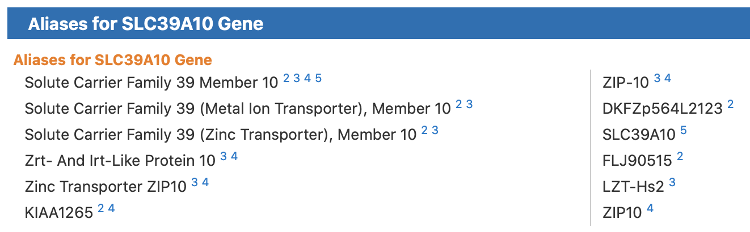
Tangent: gene names
The same gene can have a lot of different names. If you’re doing a literature search, you may also want to search for its aliases.

Slide 59
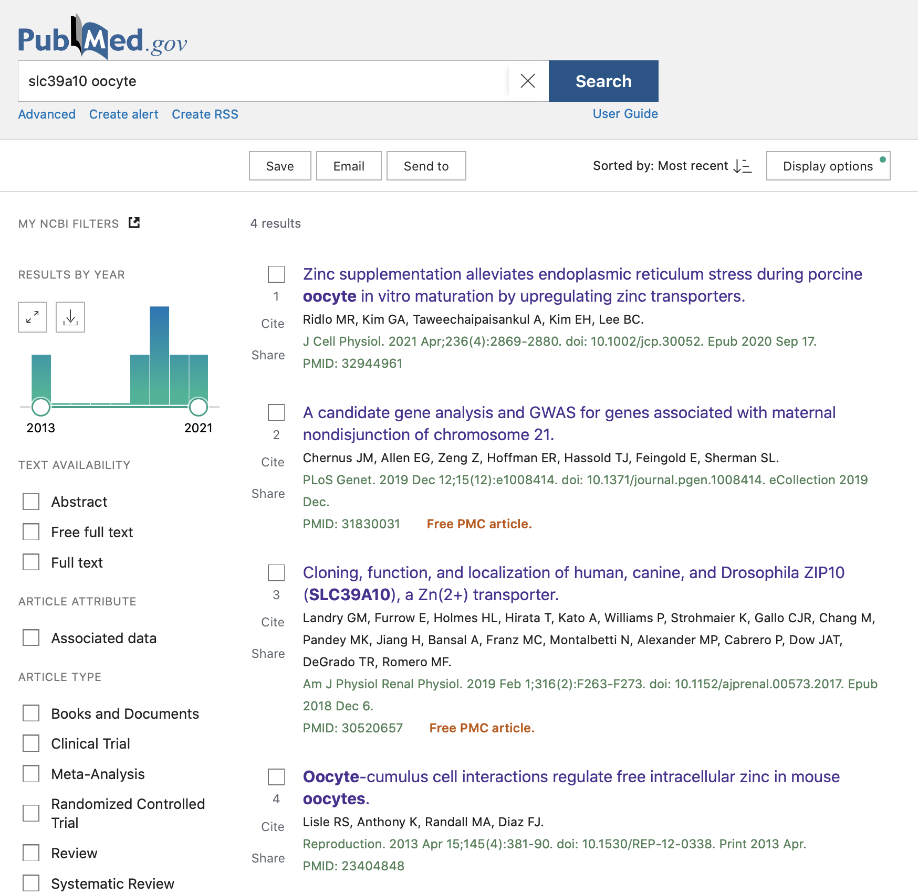
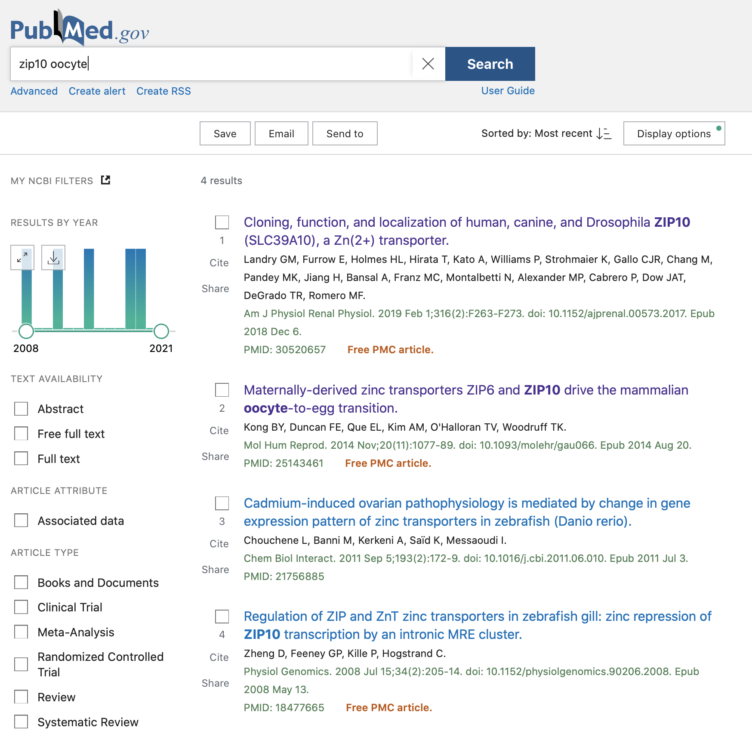
Tangent: gene names
The most interesting result doesn’t come up in the search for the official gene name.

Slide 60
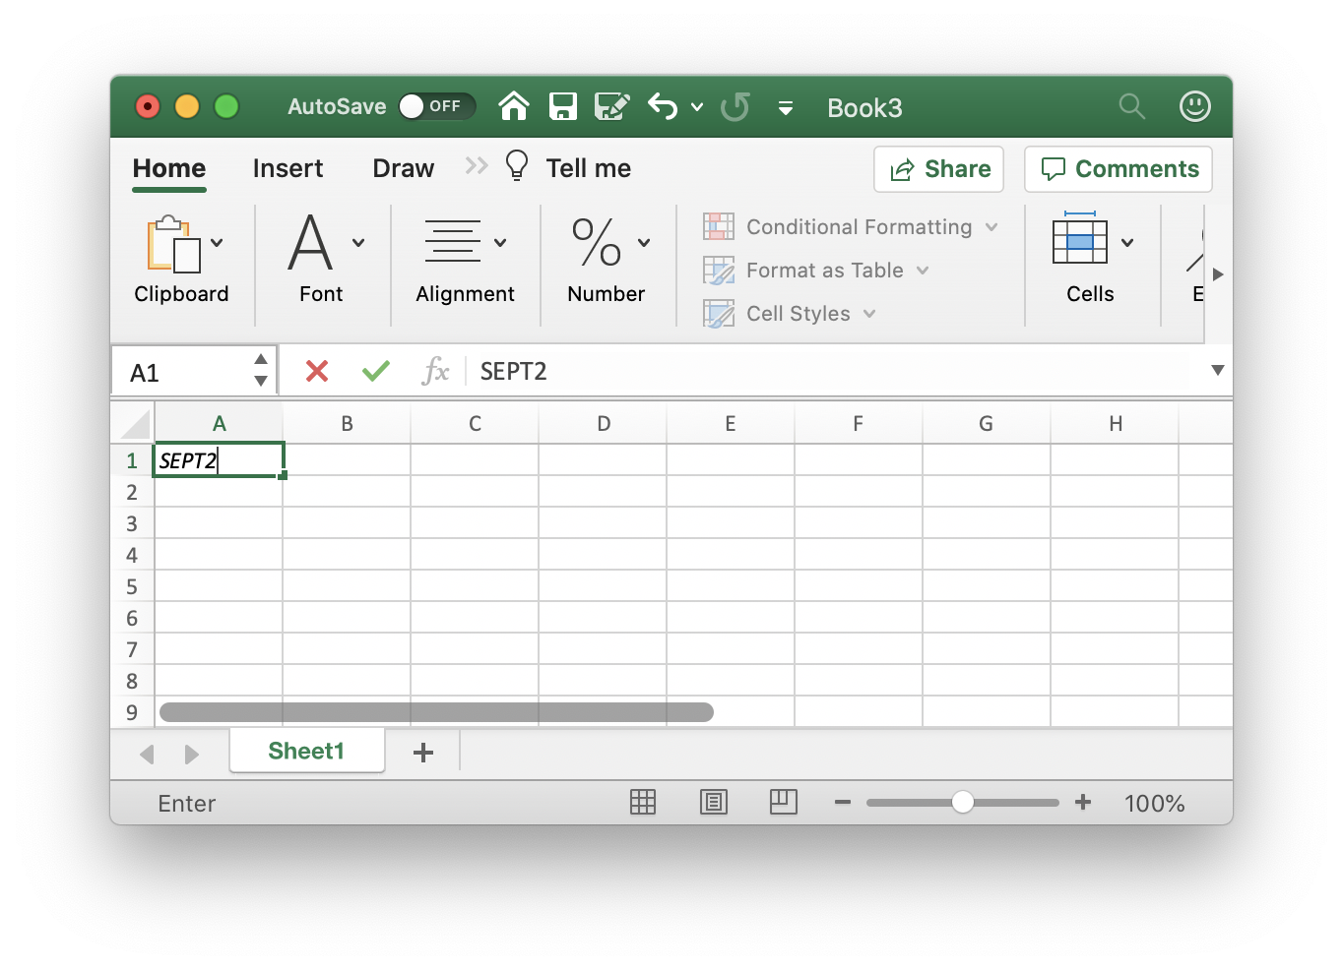
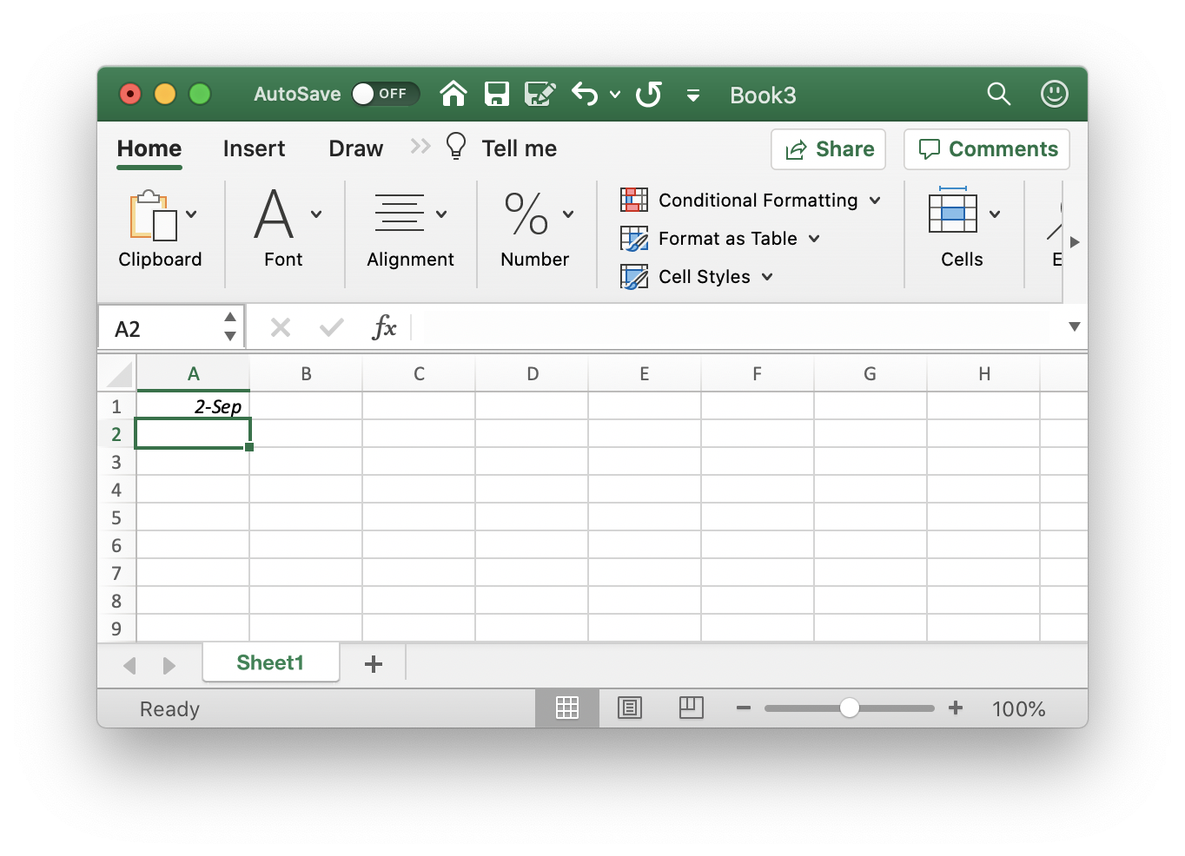
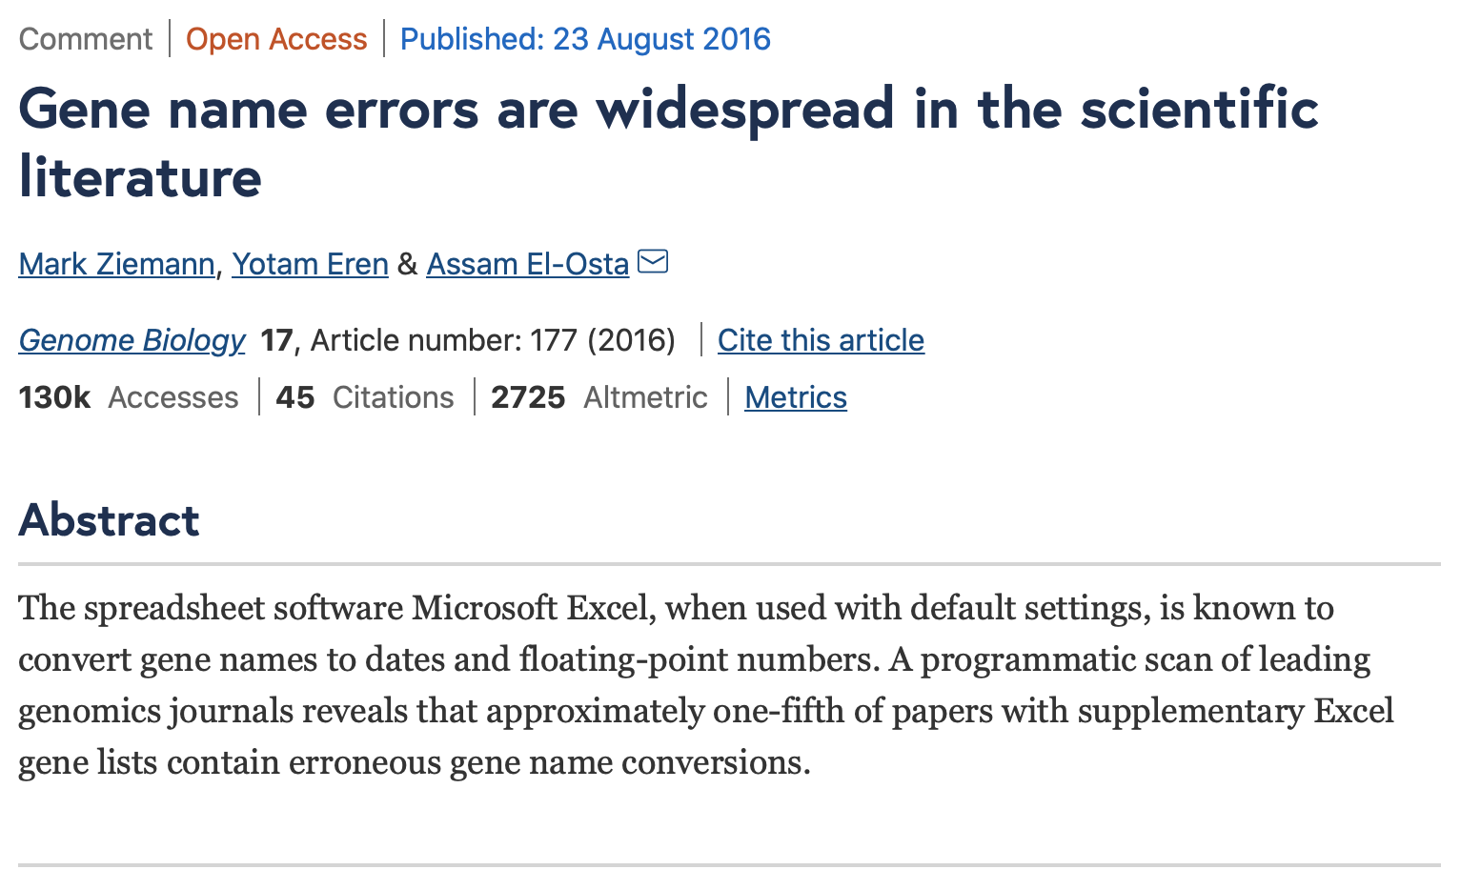
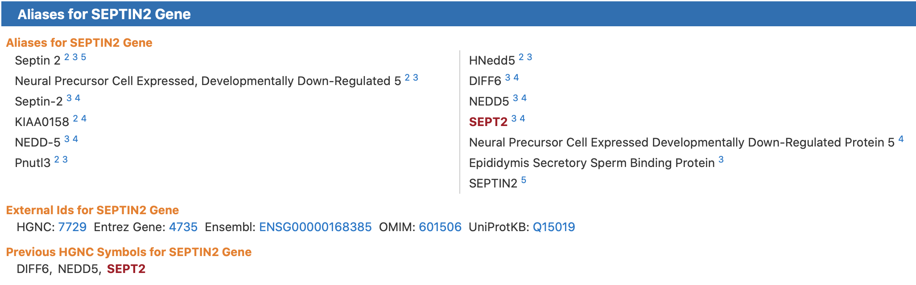
Tangent: gene names
Excel thinks this is a date

Slide 61
Exercise
Your collaborator Dr. Astley has a patient with a rare syndromic phenotype that includes a complete lack of lacrimation.
The patient’s sequencing results are contained in the file ra.vcf (reference genome GRCh37/hg19), provided on Canvas.
Try using wANNOVAR to prioritize a potentially causal variant.
Upload the file
Try tagging some relevant phenotypes
Running ANNOVAR should take ~5 minutes (?) (Or just download the ANNOVAR results provided on Canvas)
Try using the filters to prioritize a variant

